Slide 1
Preventing Page Faults from Telling Your Secrets
Shweta Shinde Zheng Leong Chua
Vishwesh Narayanan Prateek Saxena
National University of Singapore

Slide 2
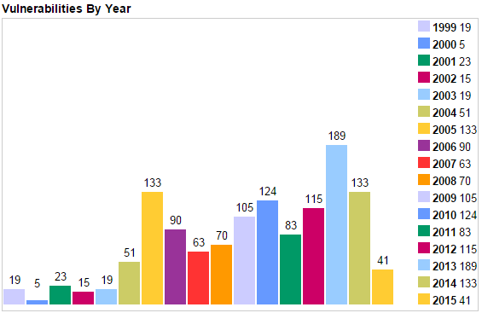
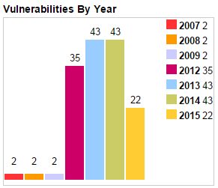
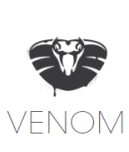
Should user application trust the OS?
Operating
Systems
Large TCB
Increases the risk of
rootkits and malware
10 MLOC
CVEs in Linux [CVE-DB]
Hypervisor
150 KLOC
CVEs in Xen [CVE-DB]

Slide 3
Hardware Isolated Enclaves
OS cannot access application’s memory
Long line of work: Overshadow, Inktag, AppShield, PodArch, Intel SGX, ….
Enclaves
Untrusted OS
Intel SGX
CPU
From October 2015, Intel has started shipping SGX support in commodity Skylake Processors

Slide 4
Problem in the Design of Enclaves
OS manages enclave resources
Opens attack surface via side channels: system calls, file I/O
Recent attack channel: Page Fault*
Memory management
Intel SGX CPU
*[Xu et al. – IEEE S&P’15]

Slide 5
Are security critical cache-hardened applications vulnerable?

Slide 6
A Real Example: AES Encryption
Virtual Memory
Enclave’s pages
idx:
1A
3E
09
46
P0
Enclave
P1
Table 1 [0], …, Table 1 [1b]
mov Table1[idx], rax
P2
Table 1 [1c], …, Table1[ff]
“Pigeonholes”
Page Accesses
Application
page table
Table 1 [0], …, Table 1 [1b]
Table 1 [1c], …, Table1[ff]
Page faults:
P1
P2
P1
P2
Physical Memory
Intel SGX CPU
Leaks 25 bits of encryption key in first round!
Notes:
Severity and defense

Slide 7
Contributions
Attacks on real crypto routine implementations
Technique to eliminate page fault side-channel
Hardware changes for lowering the overheads
10 / 24
are vulnerable
Leak 27 bits
on average
Compiler support
for annotations
Performance
Optimization

Slide 8
Pigeonhole Attack Example: Data Access
mov Table1[idx], rax
idx < 1c
idx >= 1c
P1
P2
Table 1
Input dependent data page access leaks
25 bits of information
Notes:
OS cannot directly access to program memory

Slide 9
Pigeonhole Attack Example: Code Access
ECDSA Signing Routine
P3:
0x9EB30
test_bit
ec_mul(r, G) {
res = O
nbits = |r|
for (i = nbits-1; i>=0; i--):
res = dup_point(res)
if (test_bit(r[i])):
res = add_points(res, G)
return res }
add_points
P2:
0xA6CB0
r[i]==1
ec_mul
P1:
0xA7310
r[i]==0
Input dependent code page access reveals
all the bits of ECDSA keys!

Slide 10
Impact of Pigeonhole Attacks
Analyzed Libgcrypt v1.6.3, OpenSSL v1.0.2
  Compiled with gcc v4.8.3 and LLVM v3.4
Leakage via input dependent data page access
  AES, CAST5, SEED, Stribog, Tiger, Whirlpool
Leakage via input dependent code page access
  EdDSA, powm (used by RSA, DSA, ElGamal)

Slide 11
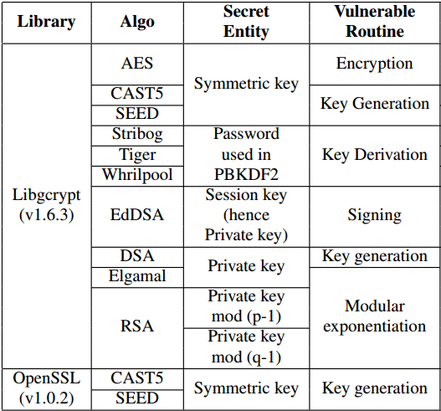
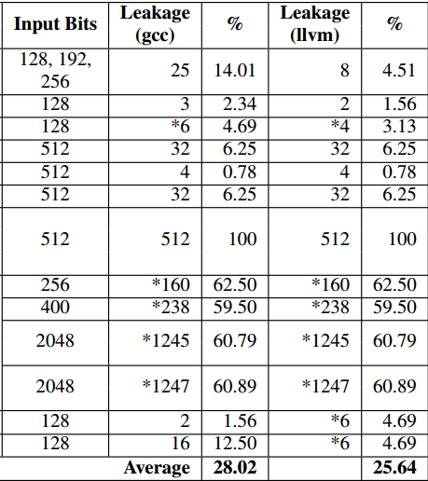
Impact of Pigeonhole Attacks
OS can infer significant number of bits

Slide 12
Defenses against Pigeonhole Attacks

Slide 13
A Software-only Defense:
Determinising Page Accesses
Observation:
OS cannot differentiate accesses in a page
Key Insight:
Confine all input-dependent memory accesses to a staging page
Program will exhibit same page-access profile independent of the input
Make the program execution Page-fault Oblivious

Slide 14
Solution Overview
Enforce Deterministic Page Accesses
Program
Source
Code
Identify Sensitive
Code & Data
Determinise
Page Layout
Rewrite
Program Instructions
Developer
Annotations
PF-Oblivious
Program
Input
Output

Slide 15
Determinising Page Layout
Enclave’s
Staging Page

Slide 16
Multiplexed Execution
Fetch all the input-dependent code / data to a staging page
Execute the dependent-logic within the staging page via a multiplexer
Save the updated values from data page

Slide 17
Example: Determinising Data Accesses
P0: Code
Staging Page
P0
mov Table1[idx],rax
mov Table1[idx],rax
P1
Table 1
Table 1
P1: Data
Staging Page
P2
Page-fault
Profile:
Page-fault
Profile:
P0 P1 P0 P2 P0 P1 P0 P2
P0 P1 P0 P1 P0 P1 P0 P1

Slide 18
Example: Determinising Code Accesses
P0: Code
Staging Page
test_bit
P3:
0x9EB30
test_bit
add_points
P2:
0xA6CB0
add_points
ec_mul
P1:
0xA7310
ec_mul
P1: Data
Staging Page
r[i]==1 or 0
Page-fault
Profile r =1
P1 P2 P1 P3 P1 P1 P2
Page-fault
Profile:
P0 P1 P0
Page-fault
Profile r =0
P1 P2 P1 P3 P1

Slide 19
More Complex Example: powm
powm
karatsuba_release
mul_mod
set_cond
Enclave’s
Staging Page
mpih_mul
karatsuba_case
mpih_divrem
mul_N, mul_N_basecase
Arithmetic Operations (addition, subtraction, shift)

Slide 20
Performance Evaluation
*All measurements were conducted on PodArch [NUS-TR]

Slide 21
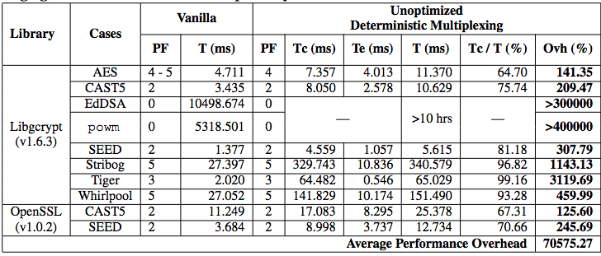
Evaluation: Unoptimized Overhead
Directly enforcing deterministic multiplexing is costly
Fetch-Save Operations Dominate the Costs

Slide 22
Incurs huge overhead for real programs
(> 4000X for powm)

Slide 23
Optimizations: Exploiting Data Locality
O1: Eliminating copy operations
Skip the save operation for read-only data
O2: Page Realignment
Merge small data blocks into a single page
Reduces fetch operations

Slide 24
Optimizations: Exploiting Code Locality
O3: Level Merging
mul_mod
Enclave’s
Staging Page
mpih_mul
karatsuba_case
mpih_divrem
mul_N, mul_N_basecase
Arithmetic Operations (addition, subtraction, shift)

Slide 25
Optimizations: Exploiting Code Locality
O4: MUX Elimination, no staging area
Code Page 1
mul_mod
mpih_mul
karatsuba_case
mpih_divrem
Code Page 2
mul_N, mul_N_basecase
Arithmetic Operations (addition, subtraction, shift)

Slide 26
Optimizations: Exploiting Code Locality
O5: Control-to-Data Dependency Transformation (if-conversion)
Input-dependent code access
Input-dependent data access
if (c) {
result = result*2;
}
staging_area[0] = result;
staging_area[1] = result*2;
result = staging_area[c];

Slide 27
End-to-end Solution
Program
Source
Code
Identify Sensitive
Code & Data
Determinise
Page Layout
Rewrite
Program Instructions
Developer Optimization
Developer
Annotations
PF-Oblivious
Program
Input
Output
Implemented as Clang-LLVM Compiler Pass

Slide 28
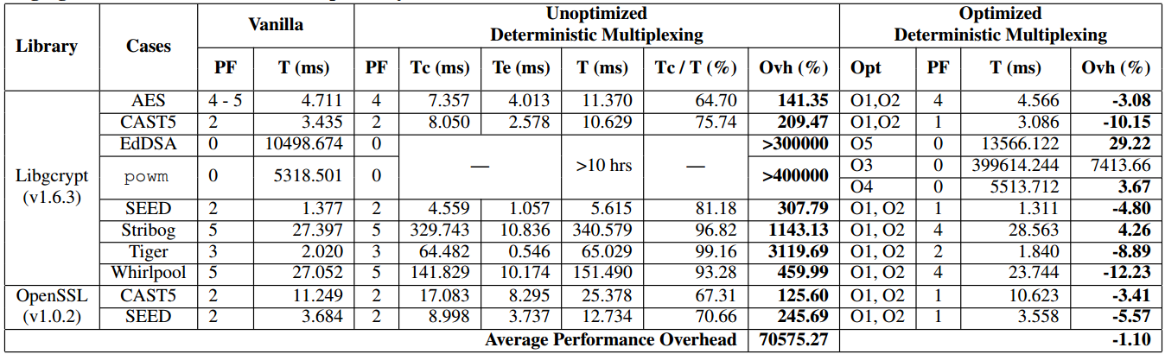
Evaluation: Effectiveness of Optimizations
Case-Specific Optimizations Are Orders of Magnitude Better!

Slide 29
Hardware-based Solution

Slide 30
Hardware Approach: Contractual Execution
Enclave
OS
Page Contract: {P1, P2, P3}
Request
Sensitive Computation
Register
Page
Fault
Enclave Fault Handler:
CPU
get TIME
wait (TIME- k)
terminate ()
Abort
Enclave

Slide 31
Potential Hardware Changes
  Inform enclave about the page-fault
    Support available in SGX v2
  Establishing and enforcing contracts
    Requires additional hardware support
Implemented as amendments to PodArch

Slide 32
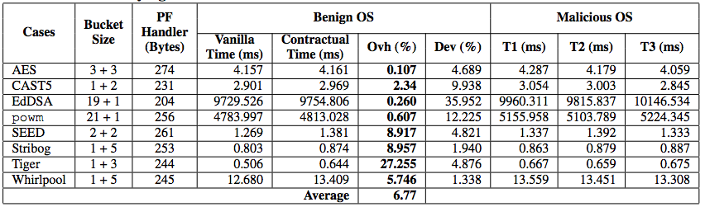
Evaluation:
Hardware-based Solution Overhead
A Simpler Defense with 7% overheads is possible with a hardware modification!

Slide 33
Related Work
Oblivious RAM
Self-paging
Cache
Hardening
Time
Bucketing
Notes:
Cache hardening
ORAM

Slide 34
Conclusion
Attacks on OpenSSL and Libgrcypt implementations
Software defense by determinzing page faults
Hardware approach reduces overhead to 6.77%
10 / 24
are vulnerable
27-100 %
leakage
Compiler support
for annotations
Max. 29.22% opt. overhead

Slide 35
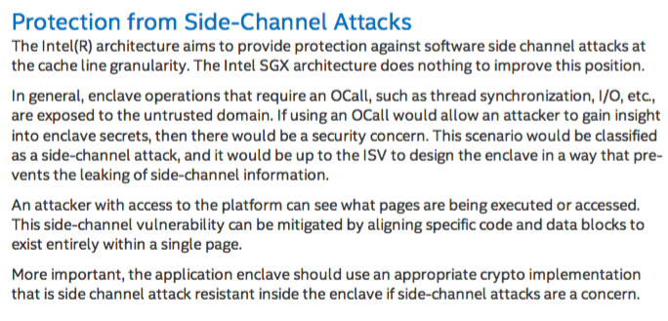
Intel’s Note for Enclave Programmers

Slide 36
Contact
Shweta Shinde
shweta24@comp.nus.edu.sg
Thank You !

Slide 37
References
[CCS’15] Y. Xu, W. Cui, and M. Peinado, Controlled-Channel Attacks: Deterministic Side Channels for Untrusted Operating Systems
[OSDI’14] A. Baumann, M. Peinado, G. Hunt, Shielding Applications from an Untrusted Cloud with Haven.
[HASP’13] F. McKeen, I. Alexandrovich, A. Berenzon, C. V. Rozas, H. Shafi, V. Shanbhogue, U. R. Savagaonkar, Innovative Instructions and Software Model for Isolated Execution
[S&P’15] Shweta Shinde, Shruti Tople, Deepak Kathayat, Prateek Saxena, Poster: PodArch: Protecting Legacy Applications with a Purely Hardware TCB
[JACM ‘96] O. Goldreich and R. Ostrovsky, Software Protection and Simulation on Oblivious RAMs
Software Guard Extensions Programming Reference Rev. 2 software.intel.com/sites/default/files/329298-002.pdf
Intel® Software Guard Extensions Enclave Writer’s Guide https://software.intel.com/sites/default/files/managed/ae/48/Software-Guard-Extensions-Enclave-Writers-Guide.pdf

Slide 38
Backup Slides

Slide 39
If staging area doesn’t fit in page?
Compacted Multiplexing with Smart Copy:
While fetching, keep over-writing the fake blocks
Copy real block in non-overlapping location in the page
OS cannot see that the copy within a page is overwriting the content

Slide 40
AES: Information Leakage Calculations
AES first round uses the first 128 bits of the key
Initial uncertainty = 2¹²⁸
OS knows for half the bits
  if the index is less than 0x1c (28 8-bit values)
Final uncertainty = 2⁶⁴ × 28⁸
Information leakage (in bits)
log₂(2¹²⁸− (2⁶⁴ × 28⁸))
  = 25.54 bits

Slide 41
Timing Channel
Crypto implementations have balanced execution trees
If the adversary can distinguish executions in the PF-oblivious execution, then he can learn that information even in absence of PF-channel

